Slide 1

SPADES GAME
SPRINT 1 REVIEW MEETING
TEAM: 10

Slide 2
INDEX
Product Backlog
Sprint Backlog
Task Board
Sprint Burndown Chart
Lessons learnt in this sprint.

Slide 3
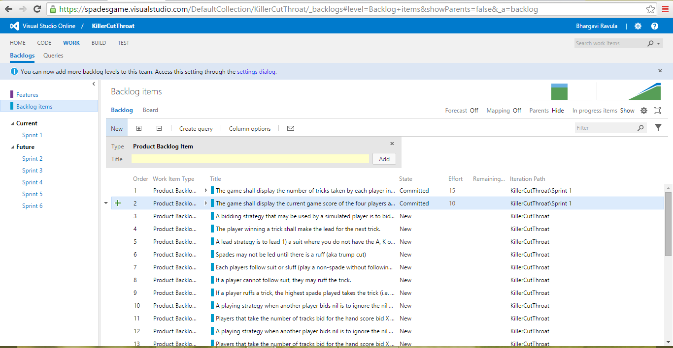
PRODUCT BACKLOG
The undone user-stories of the sprint 1 are projected on the backlog.

Slide 4
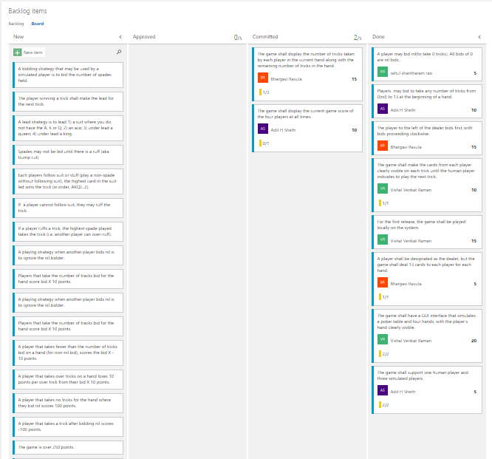
PRODUCT BACKLOG

Slide 5
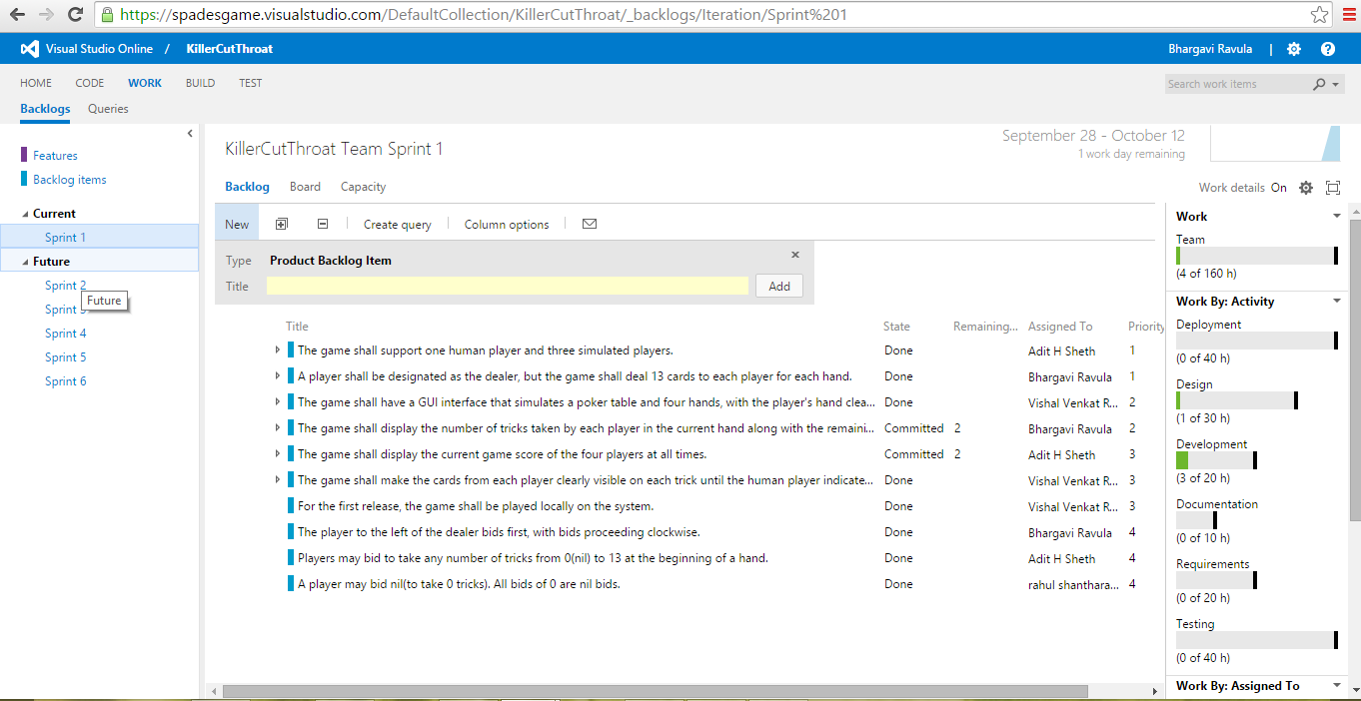
SPRINT BACKLOG

Slide 6
TECH STORIES
We’ve used Visual Studio Online(upgraded version of Team foundation Server). It is set of complementary cloud based services to helps a team write code better. It provides agile project management tools, build services, code, test and deploy.
We’ve used the Scrum development template for the project which allowed our team to effectively keep track of the user stories in the current sprint by maintaining product backlog, sprint backlog, task board and measure the progress using sprint burn down chart.

Slide 7
TECH STORIES
Image mapping techniques have been used on a series of images in an array so as to use the right image to display for the pictures of players by specifying the right pixel range while implementing the individual image.

Slide 8
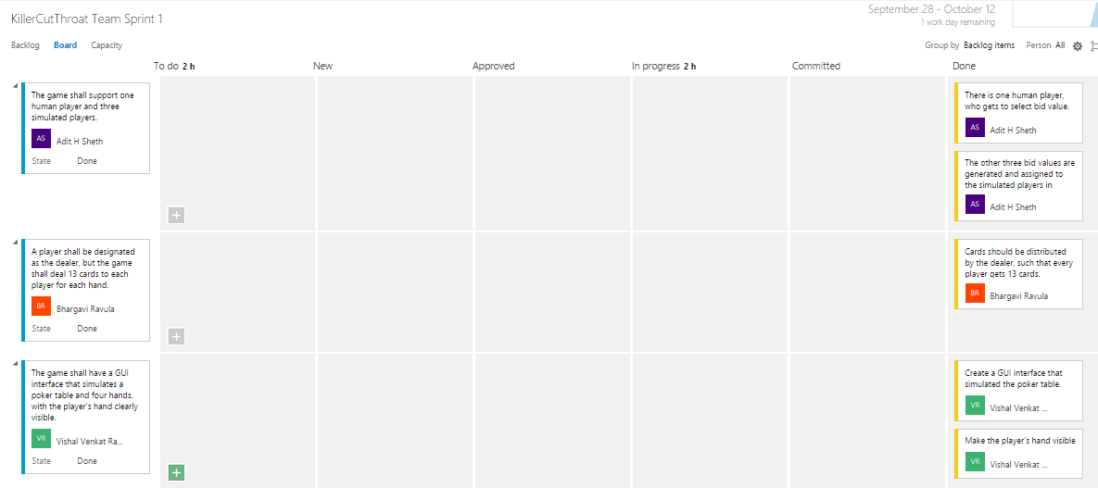
TASK BOARD

Slide 9
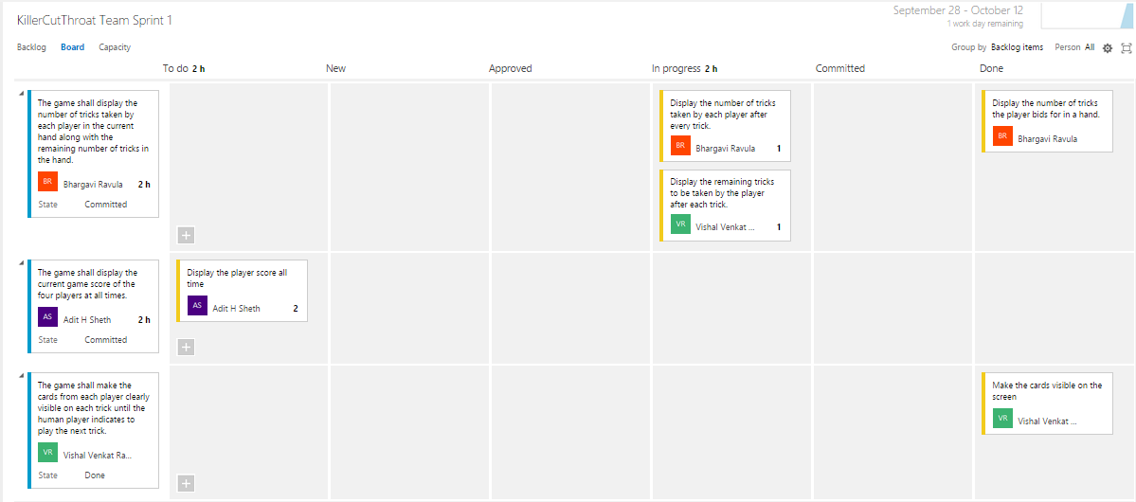
TASK BOARD

Slide 10
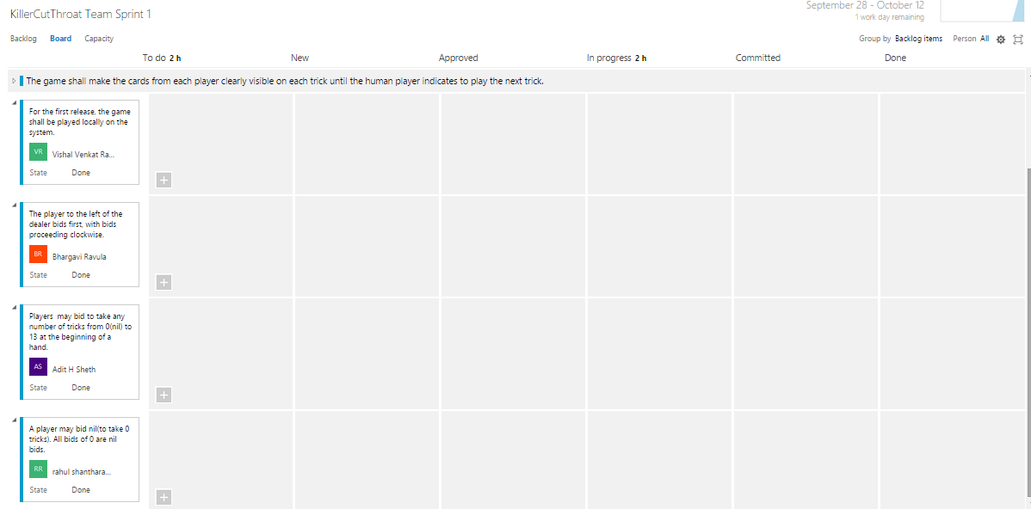
TASK BOARD

Slide 11
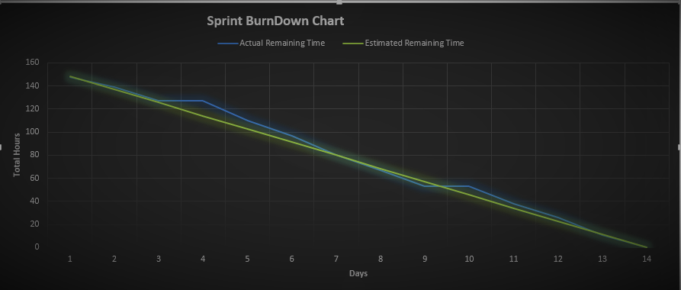
SPRINT BURNDOWN CHART

Slide 12
LESSONS LEARNT IN THIS SPRINT
Face to face meetings were more productive.
Team members if in different location, suffer from heavy or rigid governance. Thus, Small and Co-located teams work better as there is a better chance of mutual agreement.
Since, the team does not have any dedicated developers, the estimated efforts for the user stories were sometimes under estimated.

